Slide 1

Special Topic: Cybersecurity
Chapter 8: Distributed-Applications Security

Slide 2
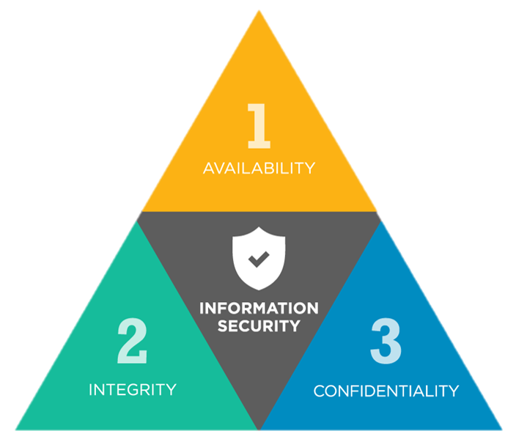
1. Database Security
Databases are crucial elements of internal networks and web applications.
Because of this, they are often the target of attacks by malicious parties seeking to gain access to this data.
An important element of computer security involves protecting the confidentiality, integrity, and availability of information stored in databases

Slide 3
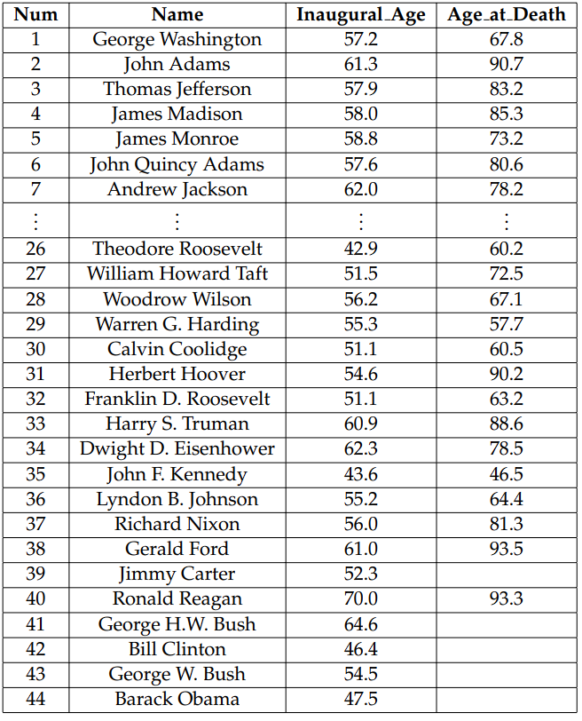
1.1 Tables and Queries
A very common way to store information is to use a relational database.
In this approach, information is organized into a collection of tables.
Each row of a table is a record that stores related information about some entity and each column is associated with an attribute that the entity can possess.

Slide 4
Database Security
Availability: gaining access to the database securely by using an in-house developed application or other means
Integrity: logs, backups, multiple servers, encryption/decryption
Confidentiality: user authentication, server authentication, admin/superuser oversight
What is Database Security?
https://www.youtube.com/watch?v=c3YaDqvSDrQ&ab_channel=IBMTechnology

Slide 5
2. Email Security
The ability to send messages and files to specific groups or individuals via the Internet is such a powerful tool that it has changed the way people communicate in general.
Because of this wide and ubiquitous usage, addressing the security of email requires that we discuss several classic security issues, including authentication, integrity, and confidentiality

Slide 6
2.1 How Email Works
Today’s email systems make use of several protocols to deliver messages.
To handle the sending of messages from a client’s machine to a recipient’s mail server, the Simple Mail Transfer Protocol (SMTP) is used.
In the SMTP model, the client is referred to as the Mail User Agent (MUA). The MUA sends an SMTP message to a Mail Sending Agent (MSA), which in turn delivers the message to a Mail Transfer Agent (MTA) responsible for transmitting the message to the receiving party.
The message is transmitted from the sender’s MTA to the recipient’s MTA, where it is transmitted to a Mail Delivery Agent (MDA) responsible for ensuring the message reaches the recipient’s MUA

Slide 7
2.2 Encryption and Authentication
The most common technique to safeguard the privacy of email is by encrypting the actual transport of messages rather than their contents.
Most mail servers support the use of SSL/TLS, protocols that securely encrypt TCP traffic. These protocols are often used at each level of communication— between the client and the local mail server, between the local and destination mail servers, and between the destination mail server and the recipient

Slide 8
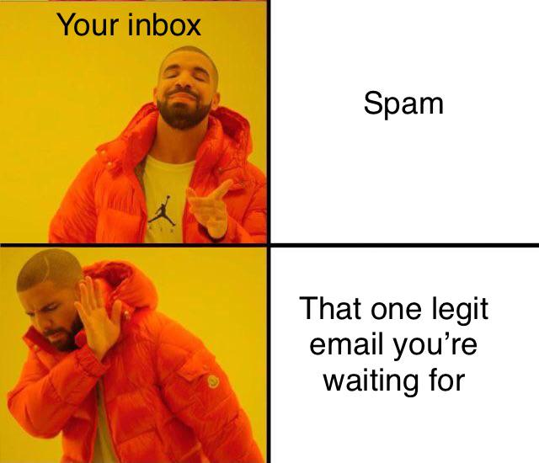
2.3 Spam
Spam email, formally referred to as unsolicited bulk email, is any form of email that is sent to many recipients without prior contact.
Spam most often contains advertisements, but can also have more nefarious motives, such as phishing and other attempts to perpetrate fraud.

Slide 9
Harvesting Addresses
There are several techniques by which spammers acquire mailing lists.
Some automatically harvest addresses by using specially designed programs that crawl the Web and collect anything that resembles an email address, a process known as spidering

Slide 10
CAPTCHAs
To combat automated email account creation tactics, most webmail services require users to solve a CAPTCHA (Completely Automated Public Turing test to tell Computers and Humans Apart).
Such a task is anything that is easily solved by a human but is difficult to solve programmatically by a computer.
Most CAPTCHAs are image recognition problems, where a distorted image containing a line of text is presented, and the user must interpret the embedded text.

Slide 11
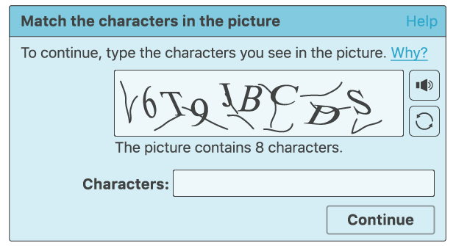
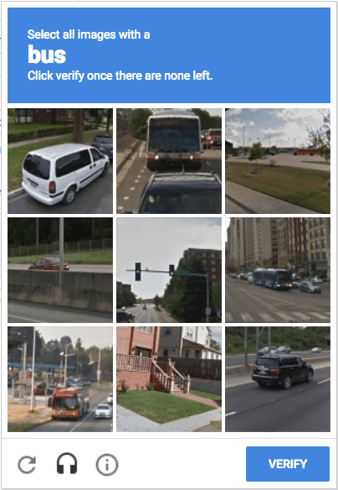


Slide 12
Blacklisting and Greylisting
One of the most popular means of preventing spam from reaching end users is by blacklisting known and suspected sources of spam and filtering incoming email based on these lists.
While maintaining an accurate blacklist would be impossible for any single ISP, there are several centralized resources devoted to aggregating lists of spam sources, which can then be downloaded by mail providers to assist in spam filtering.
Another spam-filtering technique, known as greylisting, involves the recipient mail server initially rejecting mail from unknown senders

Slide 13
Content Filtering
In the content filtering technique, network administrators deploy applications or extensions to mail servers that analyze the text and attachments of each incoming email, determine the likelihood of each email being spam, and perform actions based on this assessment
One of the most effective techniques is known as Bayesian filtering, which relies on a machine learning algorithm to gradually figure out over time how to differentiate spam from legitimate email.

Slide 14
3. Payment System 3.1 Credit Cards
Most online sales are completed using credit or debit cards.
An online credit card transaction consists of several phases, which involve several parties: the customer, the customer’s bank, called issuer, the merchant, the merchant’s bank, called acquirer, and the card network (e.g., MasterCard), called the card association

Slide 15
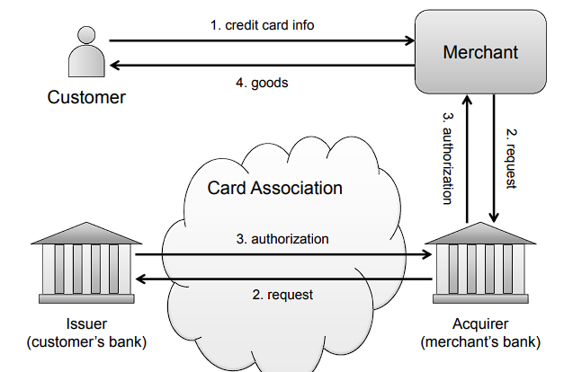

Slide 16
Credit Card Fraud, Chargebacks, Cancellation, and Prepaid Credit Cards
United States law limits the liability of cardholders to $50 in the event of fraud, regardless of how much money was spent. This law protects citizens from financial hardship due to fraud.
In addition, every customer has the ability to initiate a chargeback if a fraudulent or otherwise incorrect purchase appears on their billing statement.
In the event of a chargeback, the merchant is given the opportunity to dispute the claim, at which point the case would be mediated by both the merchant and customer banks.

Slide 17
Credit Card Fraud, Chargebacks, Cancellation, and Prepaid Credit Cards
Credit card issuers have dedicated phone numbers for the cancellation of a lost or stolen card. Once a card is canceled, all transactions that use the card are denied.
To further protect consumers, banks monitor customer purchasing patterns and apply fraud detection techniques to determine the likelihood that a given purchase is fraudulent.
Prepaid credit cards, also known as stored-value cards, are becoming an increasingly popular alternative to traditional credit and debit cards.
Unlike credit cards, which allow owners to make charges on credit, or debit cards, which are linked to a banking account, prepaid cards are initialized with a specified balance before being issued.

Slide 18
4. Digital-Rights Management
With all the media that has been digitized, there is a serious concern about how to protect the copyright holders of that content. Digital-rights management (DRM) addresses this concern. DRM refers to the practice of restricting the capabilities users have with respect to digital content.
DRM schemes are frequently applied to digital media, such as DVDs and downloaded music, as well as licensed software.

Slide 19
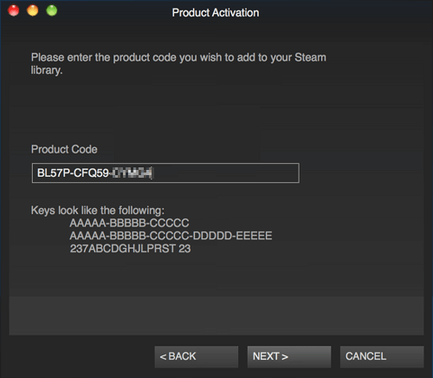
4.1 Digital-Media Rights Techniques
A common applications of DRM is protecting digital-media content from unauthorized duplication and from playing on unlicensed devices.
Can be done by encryption, key revocation, key activation, and other means.

Slide 20
4.4 Legal Issues
The widespread adoption of the Internet has created a convenient avenue for piracy of both software and media content.
DRM itself has been the subject of several legal decisions as well. Most notably, the Digital Millennium Copyright Act (DMCA) was passed in 1998, which dictates that reverse engineering and circumvention of a technology designed to restrict access to a work protected under copyright law is illegal if done with the intent of violating that copyright

Slide 21




5. Social Networking
Social networking refers to the use of online communities designed to facilitate contact between groups of people and individuals with general interests or a wide variety of special interests, ranging from dating to job searches to photography

Slide 22
5. Social Networks as Attack Vectors
The increased levels of communication and trust can act as attack vectors
First, these web sites typically provide many channels of communication between users, including the ability to be contacted by strangers, who might actually be engaged in information-gathering attacks
Another attack risk for social networking web sites comes from the fact that they are highly interactive, dynamic web applications. For instance, several social networking web sites allow third parties to write applications that run inside the security domain of the site.

Slide 23
5. Social Networks as Attack Vectors
In addition, because they support various kinds of interactive user communication, social networking web sites are potential vectors for cross-site scripting attacks.
Such attacks can leverage code executed in a victim’s browser to propagate XSS worms, links to malware, or spam advertisements

Slide 24
5.2 Privacy
With the growing popularity of social networking web sites, people are more frequently making personal information public and visible to at least some portion of the Internet = digital footprint
For example, it is not uncommon for employers to search for personal information on social networking sites to gather additional data on prospective job candidates.

Slide 25
5.2 Privacy
Because of these risks, social networking sites must take three important steps to protect the privacy of their users.
First, users must be given complete control over what personal information is available to what parties.
Second, privacy settings must be assigned restrictive default values to protect users who are unwilling or unable to configure their own privacy preferences
Finally, social networking sites have an obligation to clearly dictate policies regarding sharing of user information. Users should be aware of how their personal information can be accessed and used by third parties.

Slide 26
Picking A Cybersecurity Path
Cyber Security Paths | The LAST Roadmap You'll Ever Need
https://www.youtube.com/watch?v=bMHd4qS2o2w&ab_channel=MadHat

